Slide 1
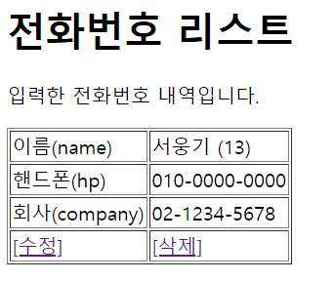
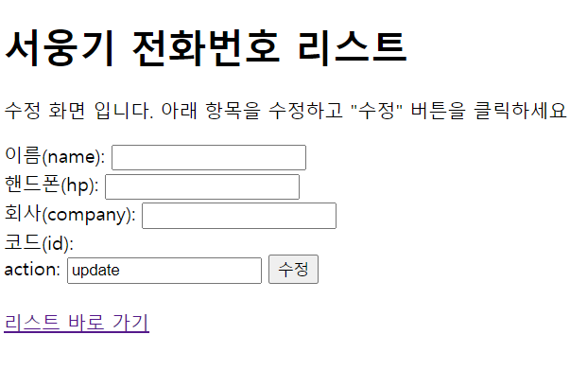
phonebook2 개요 및 분석
01
분석-업데이트폼
Tomcat
Rqeust(요청)
phonebook2
Request header
Request body
Contoller(servlet)
객체
phoneDao 객체
uform일때
PersonUpdate();
http://localhost:8088/phonebook2/pbc?action=uform
rquest
uform
response
포워드
updateForm.jsp
객체
Response(응답)
Response header
Response body
(html)
DB
http://localhost:8088/phonebook2/pbc?action=list

Slide 2
phonebook2 개요 및 분석
01
분석-업데이트
action=update&name=?&hp=?&company=?&personalId=?
http://localhost:8088/phonebook2/pbc?action=uform
Rqeust(요청)
Tomcat
phonebook2
Request header
Request body
(파라미터)
Contoller(servlet)
객체
phoneDao 객체
rquest
update일때
personUpdate()
response
리스트 요청
Response(응답)
Response header
Response body
(리다이렉트코드)
DB
http://localhost:8088/phonebook2/pbc?action=list

Slide 3
phonebook2 개요 및 분석
01
분석-삭제
http://localhost:8088/phonebook2/pbc?action=delete
action=delete&personalId=?
Rqeust(요청)
Tomcat
phonebook2
Request header
Request body
(파라미터)
Contoller(servlet)
객체
phoneDao 객체
rquest
delete일때
personDelete()
response
Response(응답)
리스트 요청
Response header
Response body
(리다이렉트코드)
DB
http://localhost:8088/phonebook2/pbc?action=list

